Slide 1


Console-Based Java Mini Project: Bank Account Management System
Name: A.Rupasri
ID NO:22G21A3108
Department: CSE(AI)
College: Audisankara college of Engineering and technology

Slide 2




Abstract
Account Creation
Deposit & Withdrawal
Allows users to create new savings or current accounts with initial deposits, assigning a unique account number.
Facilitates secure transactions for depositing funds into and withdrawing from existing accounts, with validation.
Balance Inquiry
User Authentication
Provides an instant view of the current account balance upon user request, ensuring real-time data access.
Implements a basic user authentication system for secure access to account functionalities, safeguarding user data.

Slide 3
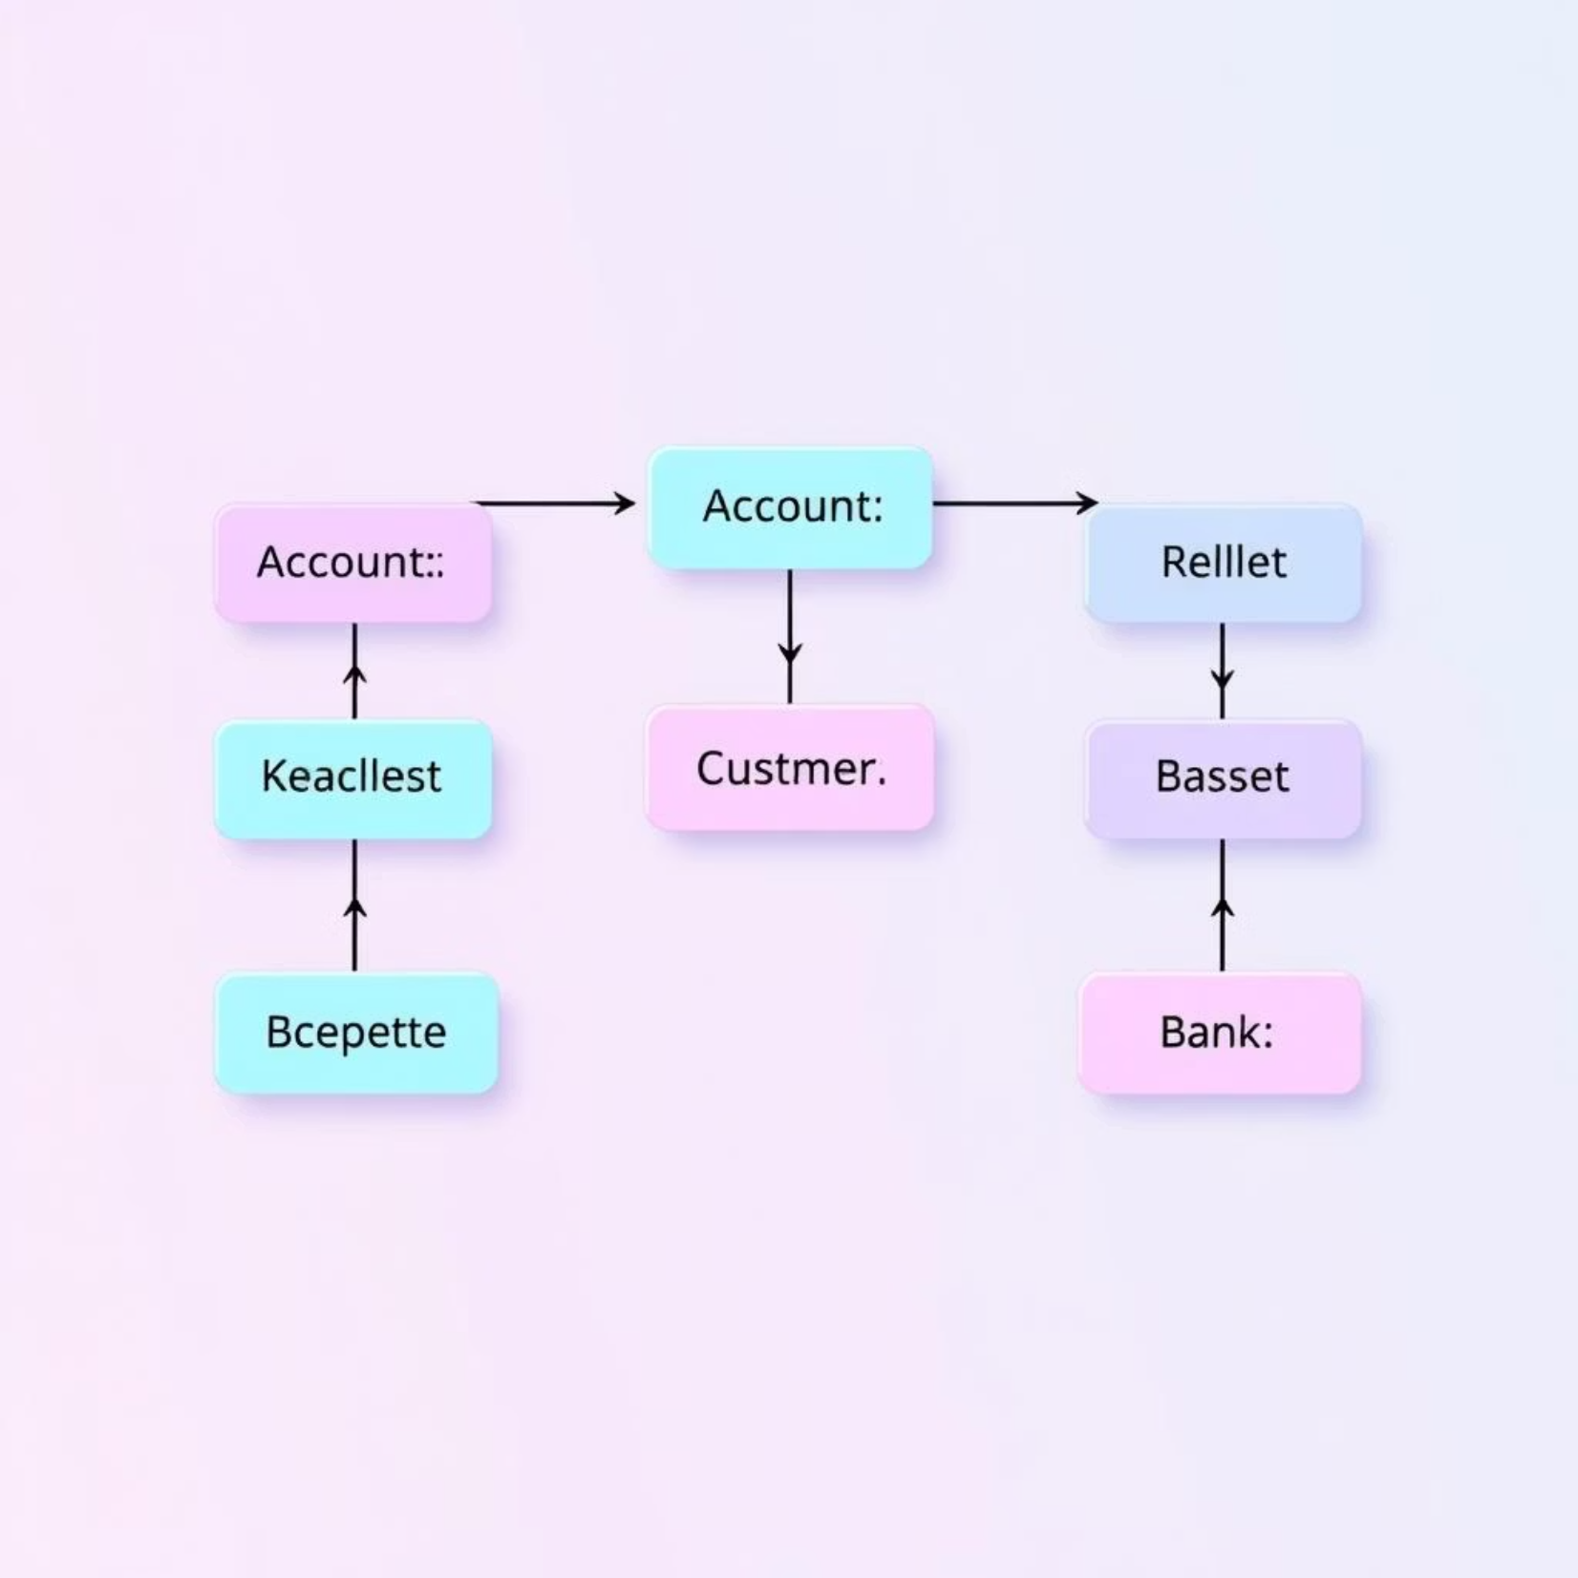
System Architecture and Design Principles
The system follows an object-oriented design, leveraging Java's core principles to ensure modularity and extensibility. Key components include:
Account Class: Manages account data and core operations.
Customer Class: Stores customer details and links to accounts.
Bank Class: Acts as a central repository for all accounts and customers.
Console Interface: Handles user input and displays output.

Slide 4



Technologies and Development Environment
Java SE
Console I/O
Data Structures
The entire project is built using Java Standard Edition, utilising fundamental concepts like classes, objects, inheritance, and exception handling.
Input and output operations are handled via the standard console, providing a straightforward, text-based user experience.
In-memory data structures, such as ArrayLists, are used for temporary storage of account and customer information during runtime.

Slide 5
Challenges and Learning Outcomes
Error Handling
Input Validation
Developing effective exception handling mechanisms for scenarios such as insufficient funds or invalid account numbers.
Implementing robust checks to prevent invalid data entry and ensure system stability, like numeric inputs and positive amounts.
Problem-Solving Skills
Object-Oriented Programming (OOP)
Enhanced analytical and logical thinking to design and debug a functional system from scratch, addressing various use cases.
Deepened understanding of OOP principles through practical application, including encapsulation, abstraction, and polymorphism.

Slide 6

Future Enhancements and Conclusion
Potential Enhancements
Database integration for persistent data storage.
Graphical User Interface (GUI) for improved user experience.
Transaction history logging for each account.
Support for multiple currencies and international transfers.
Key Takeaways
This project provided valuable hands-on experience in Java programming, demonstrating the practical application of theoretical concepts in building a real-world system. It solidified my understanding of system design, error handling, and user interaction.

Slide 7
THANK YOU

